Slide 1
Full Stack Web development
Lecture 7: Advanced CSS

Slide 2
Today:
Advanced CSS
Selectors Revisited
Pseudo-classes and Pseudo-elements
CSS Box Model
Positioning and Display
Size Units
Lab: Building a dropdown navigation using CSS and HTML

Slide 3
Selectors: Revisited
Recall:
* {} – selects all elements
p {} – selects all p elements
.className {} – selects all elements with class=“className”
#elementID {} – selects an element with id=“elementID”
p.hidden {} – selects all p elements with class=“hidden”
p .hidden {} – selects all elements inside p tags with class=“hidden”
p, .hidden {} – selects all p elements AND all elements with class=“hidden”

Slide 4
Selectors: Additional Combination Selectors
Recall:
p > .hidden {}
– selects all elements with class=”hidden” that are children of p
p + .hidden {}
– selects all elements with class=“hidden” that are immediately after p
p ~ .hidden {}
– selects all elements with class=“hidden” that are siblings of p (same level)
a[href=“https://disney.com”] {}
-selects all a elements with an href=”https://Disney.com”

Slide 5
Selectors: Pseudo-classes
Have you seen links that change color when you hover over them or they become underlined? This is through pseudo-classes.
a {
text-decoration:none;
}
a:hover {
text-decoration:underline;
}

Slide 6
Selectors: Pseudo-classes
Links (works on div too!)
:link
:visited
:hover
:active
Specific Elements
:first-child
:first-of-type
:not(selector)
:nth-child(n)
:nth-last-child(n)
Forms
:checked
:disabled
:enabled
:focus
:required
:optional
:valid
:invalid
:read-only
:read-write

Slide 7
Selectors: Pseudo-elements
Another type of selector (notice the double colon):
p.headline::after { content: “Date: “ }
::after – insert content after an element
::before – insert content before an element
::first-letter – select the first letter of an element
::first-line – select the first line of an element

Slide 8
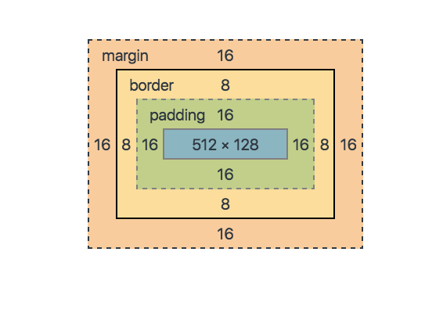
CSS Box Model
As you’ve been playing around with placement of items you’ve probably struggled with the CSS box model.
Each element of CSS can be considered a box that has margin, border and padding.
Let’s play around with some margin and padding and see why it’s important.

Slide 9
Positioning and Display
The position property:
static – this is the default
relative – relative to normal position
fixed – relative to the viewport
absolute – relative to nearest positioned parent, or the document body
sticky – positioned based on scroll positioning.
positioning must be used in conjunction with top, bottom, left, and right CSS properties.
The display property:
block – always starts on a new line and takes up the full width available to it.
inline – can start anywhere and only takes up as much space as needed
none – removed from the page
The visibility property:
visible – the default option
hidden – hidden from the browser but the space allocated still displays in the browser.

Slide 10
Size Units
Many CSS properties require sizing to be defined. Up until now we have used px (pixels). There are other alternatives.
Fixed Sizes:
px (pixels) 96dpi
pt (points) 72dpi
pc (picas) 1pc = 12pt
Relative Sizes
em (relative to font-size of current element)
% (relative to the parent element)
vw (relative to the viewport width)
vh (relative to the viewport height)
It is a best practice to use relative sizes in production environments as they provide the best support for accessibility and RWD

Slide 11
Responsive Web Design
One last thought on Responsive Web Design in this segment of the course.
You already have all the tools necessary to build it (media queries, positioning, % based sizing), we will add a few more tools as we progress in the course, but it’s worth noting that as you build assignments from here on out, you should think about how it looks across all devices.
Here’s a great beginners tutorial if you want to learn more.
https://www.w3schools.com/html/html_responsive.asp

Slide 12
Lab – Building a Nav Bar with only CSS
Demo – in class we will build a CSS drop-down nav bar using only the skills we have learned.

Slide 13
Homework – Due 10/10
Going forward all homework will be submitted through GitHub. You must upload your code into your homework folder of your classwork repository, not the group project, and then submit a Pull Request to dadkins20.
Add an interactive navigation to your about me page. Using CSS positioning, have it fixed at the top of the page as the user scrolls down. It should have at least one top level drop-down and one secondary level drop down.
Continue working on your group project
Not homework but a reminder: practice writing as much code as you can. It’s the best way to learn.
This concludes our work on Cascading Style Sheets, from here we move into the basics of JavaScript, which will be a major focus for the majority of the class from here on out. Make sure you have an excellent grasp of HTML and CSS.

